Slide 1

ASAR
Arabic ManuScript Analysis and Recognition system

Slide 2
Team Members
Mohamed Abdelrahman
Mohamed Gamal
Nourhan Mahmoud
Ola Abdallah
Supervised By:
Dr. Mohamed Kayed

Slide 3
Outline
01
05
Introduction & Motivation
System Architecture
02
06
Market Survey
Project Modules
03
07
Feasibility Study
Project Results
04
08
Contribution
Future Work

Slide 4
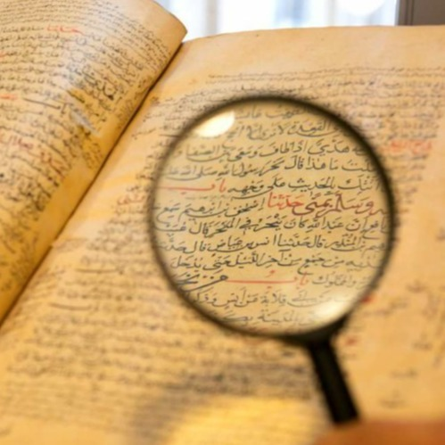
Introduction
1
Digitizing Historical Arabic Manuscripts
Enrich Arabic Content
2
Search Engine
3
Hybrid Deep Learning Model
4

Slide 5
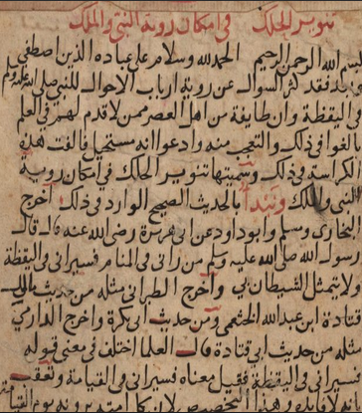
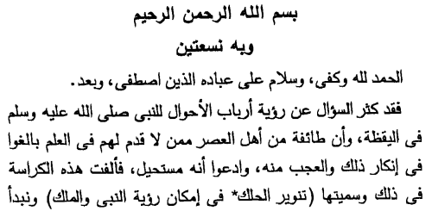

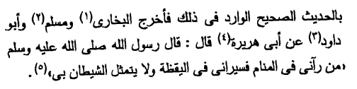
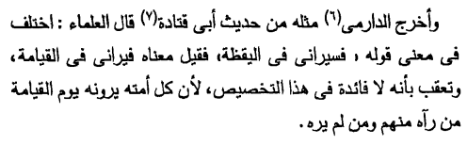
Motivation

Slide 6
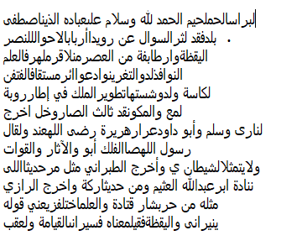
Market Survey
Sotoor RDI

Slide 7

Market Survey
Transkribus

Slide 8



Feasibility Study
Digital Transformation
01
Non-Specialized Students
Manuscript Investigators
03
02

Slide 9
Contribution
01
Prepared VML-HD dataset
02
Word Spotting (PHOSC CNN model)
03
Arabic Alphabet representation
04
Word Segmentation (morphological)
05
Generate transcripts for each segment

Slide 10
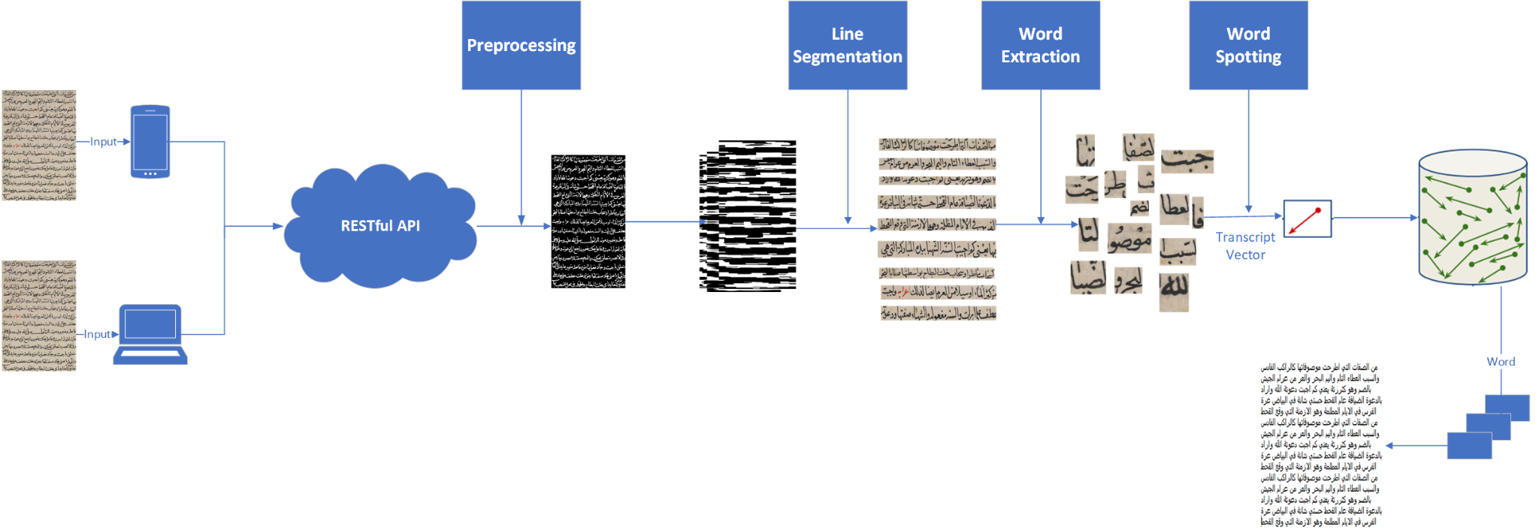
System Architecture

Slide 11
Dataset Preparation
01
IBN SINA Dataset
Taken from a philosophical book by Ibn Sina.
The dataset consists of 51 folios which correspond to 20722 CCs (almost 500 CC on each folio).
02
KHATT Dataset
Collected from the web along with their ground truth.
Includes Arabic diacritics.
That closely resemble the old fonts used in historical manuscripts (dating back to the 18th century).
03
RASAM (maghrebi) Dataset
is made up of 300 annotated image.
Images come from three manuscripts.
04
This dataset is based on five books written by different authors in the years 1088 - 1451.
668 pages are annotated at the sub-word level.
It consists of 157,889 subwords.
VML-HD Dataset

Slide 12
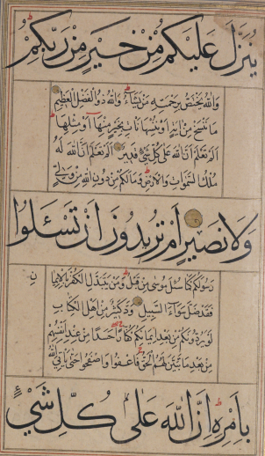
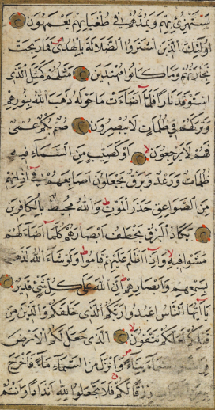
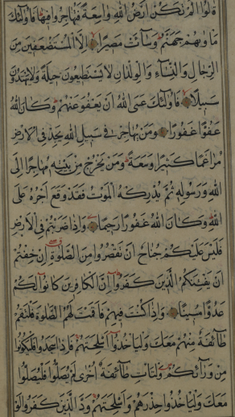
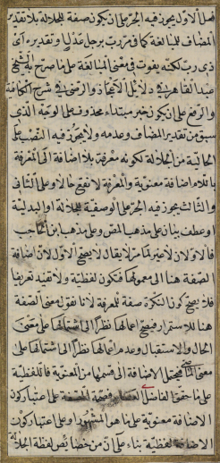
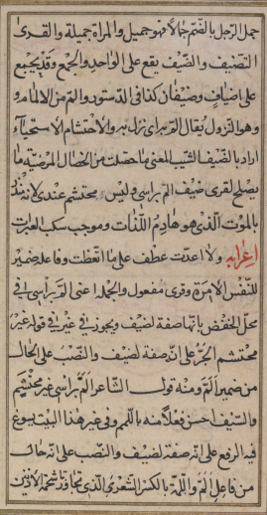
VML-HD Dataset

Slide 13
Data Preparation
Extract items in 157,889 images with
6,180 Class
Homography Augmentation
Then we used Affine Transformation from the OpenCV library
Segmentation
Data Augmentation
Data Cleaning
Become 104,310 total images with
5,429 class

Slide 14
Page Segmentation
There are Three Steps to segmenting a page:
Step 1
Step 2
Step 3
Image Preprocessing
Line Segmentation
Word Segmentation

Slide 15
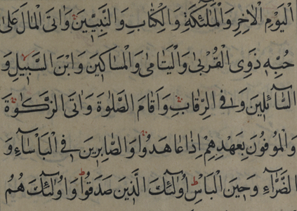
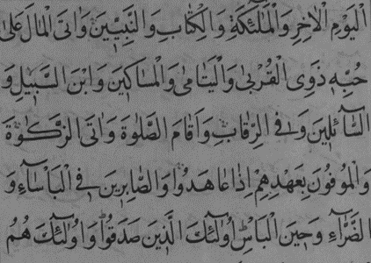
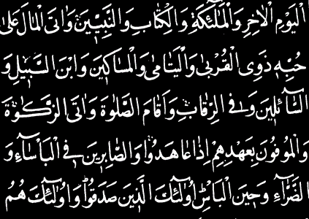
Preprocessing before Line Segmentation
Converting an image to black and white by using Threshold Binary, Inverted operation.
Original image
gray scale image
Binary Inverted image

Slide 16
Line Segmentation
Text-Line Segmentation consists of two steps:
Step 1
Step 2
Morphology
Find Contours

Slide 17




Morphology
- Constructing bridge between the components.
Binary Image
After Applying Closing
After Applying Erosion
After Applying Dilation
Notes:
There are many morphological operations such as Erosion, Dilation, Opening and Closing.
Morphology Technique is used for constructing bridge between the components. This means that each connected pixel component represents a line of text.

Slide 18
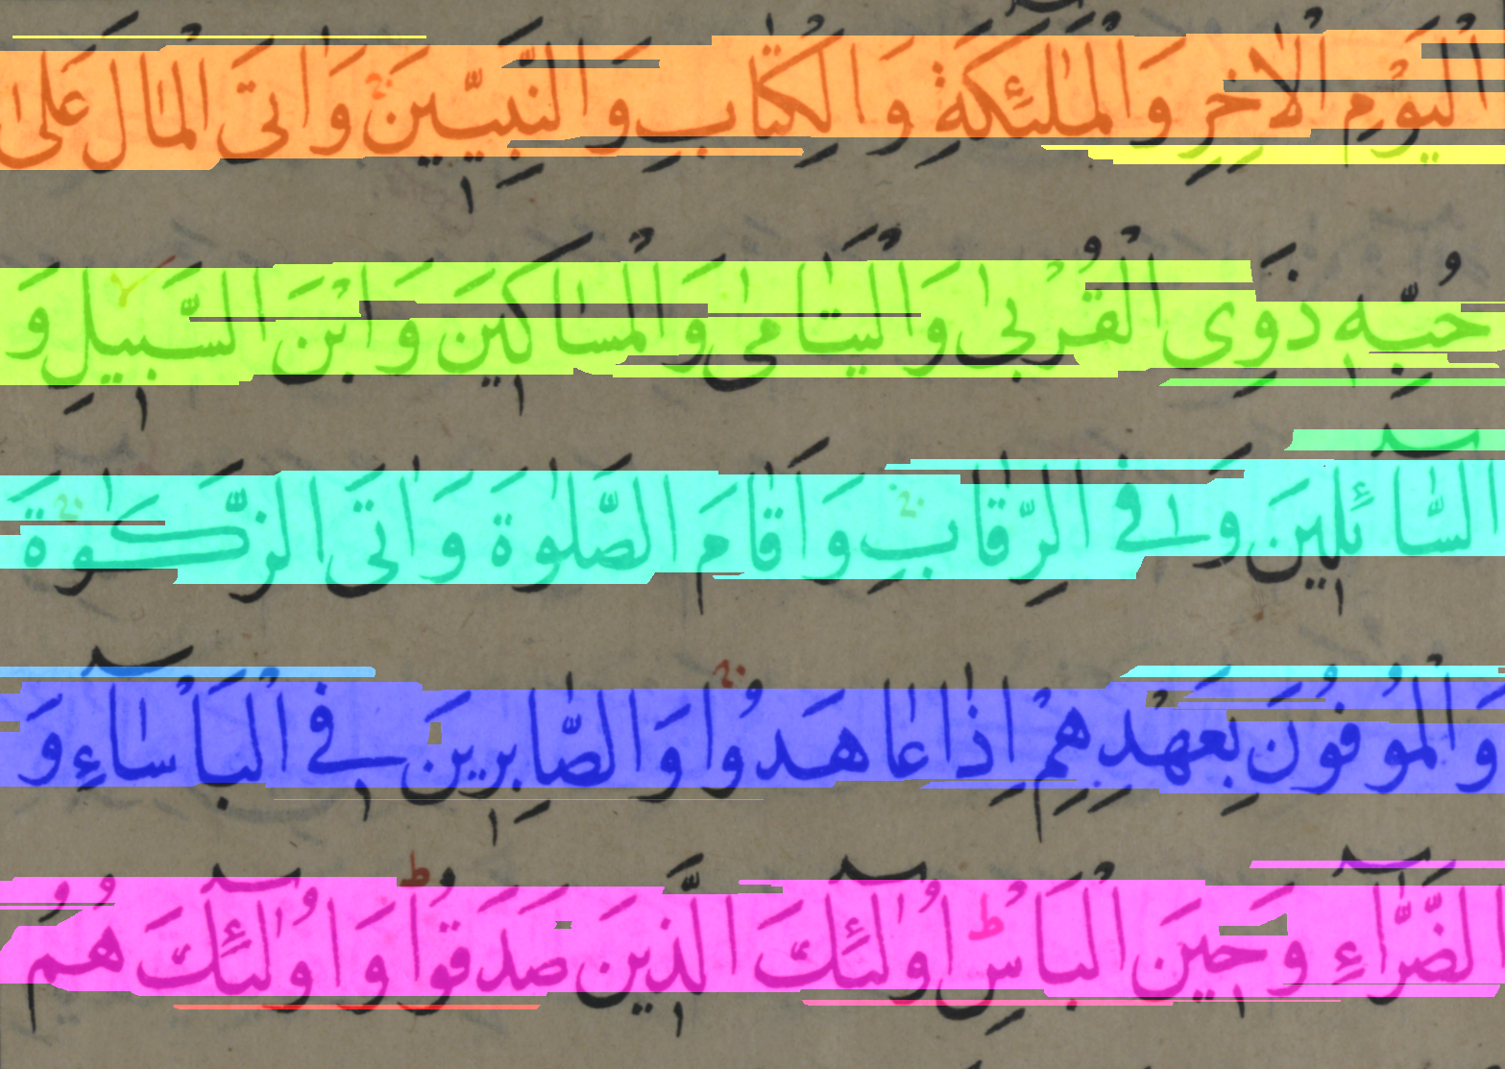
Morphology
Show all connected regions in the dilated image.
Dilated Image
After Applying Connected Component Labeling

Slide 19
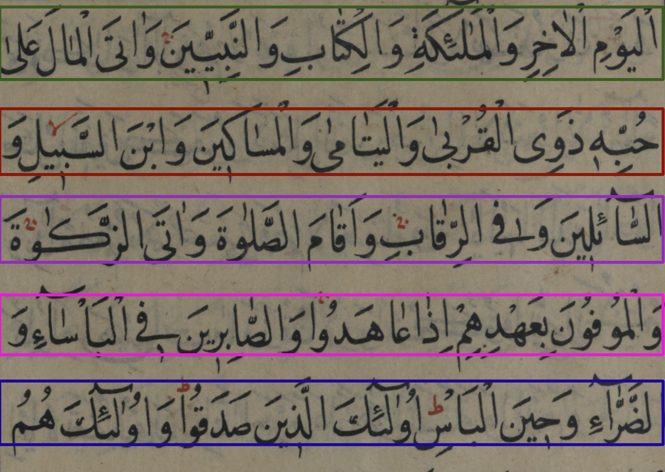
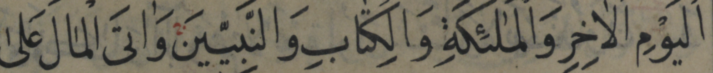
Finding Contours
Extract individual text lines by finding contours in the dilated image, and check all the areas of each of the contours to identify which contours correspond to our areas of interest.
Notes:
Contours are typically used to find a white object from a black background. All the above image processing techniques are applied so that the Contours can detect the boundary edges of the blocks of text of the image.

Slide 20
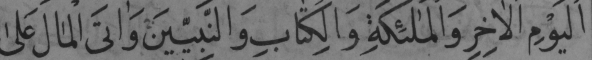


Preprocessing before Word Segmentation
The same thing we did in preprocessing before line segmentation. In addition to remove noise, tashkeel and dotes.
Original Image
Gray Scale Image
Binary Image
Remove Noise

Slide 21
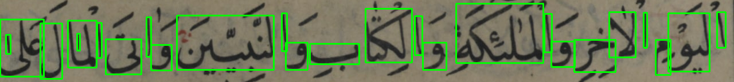
Word Segmentation
After Preprocessing, We apply
Finding contour on each lines.
Extract each sub-words from line.

Slide 22
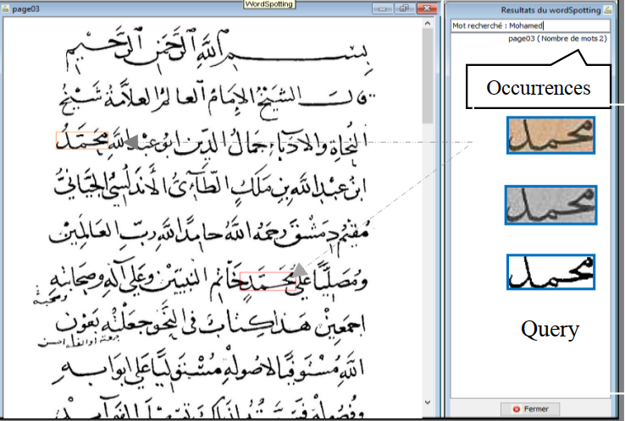
Word Spotting
- Pattern Recognition technique based on template matching.
- Query by Example (QBE)
- Query by String (QBS)
- Efficient alternative to OCR

Slide 23
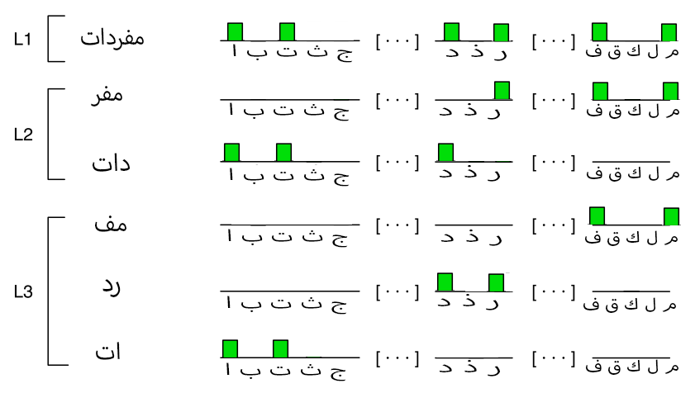
Pyramidal Histogram of Characters (PHOC)
Encodes weather a particular character appears.
Used as a character attributes (textural descriptor)

Slide 24
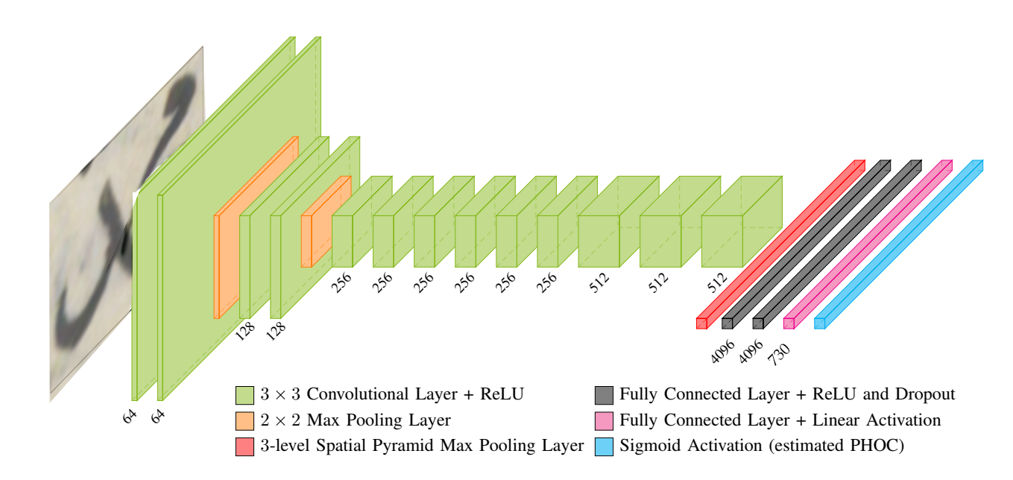
PHOC Network

Slide 25
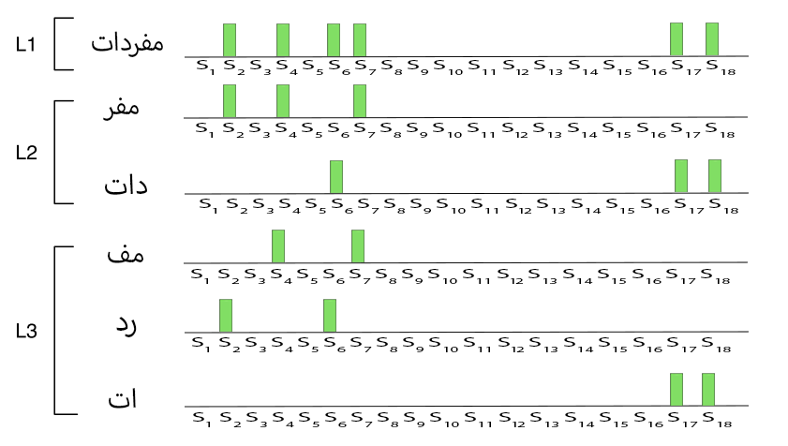
Pyramidal Histogram of Shapes (PHOS)
Zero-Shot learning technique.
Attribute signature representation.

Slide 26
Pho(SC)Net
Hybrid vector representation
PHOC + PHOS
PHOC => Sigmoid, PHOS => ReLU
Output Layer
PHOSC
Predicted word label with highest similarity value
Cosine Similarity

Slide 27
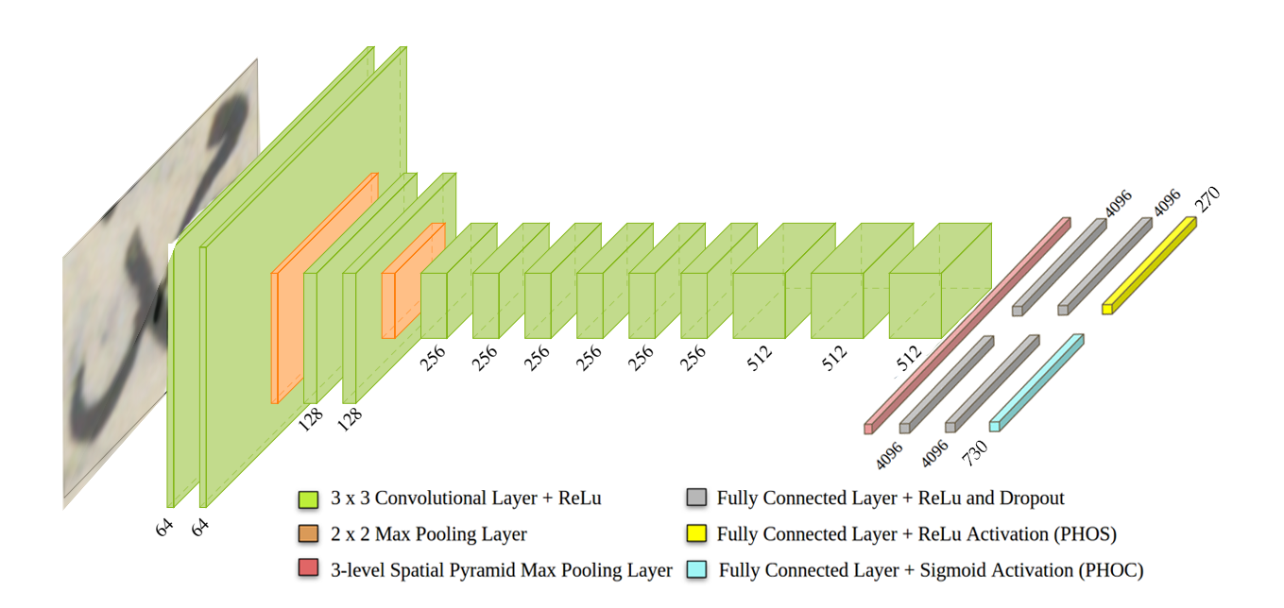
Pho(SC)Net Architecture

Slide 28
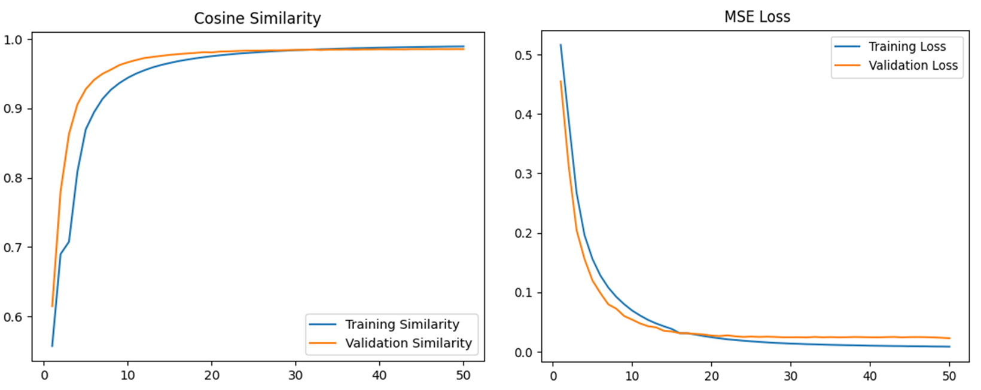
Model Results
Training PHOSC on the dataset

Slide 29
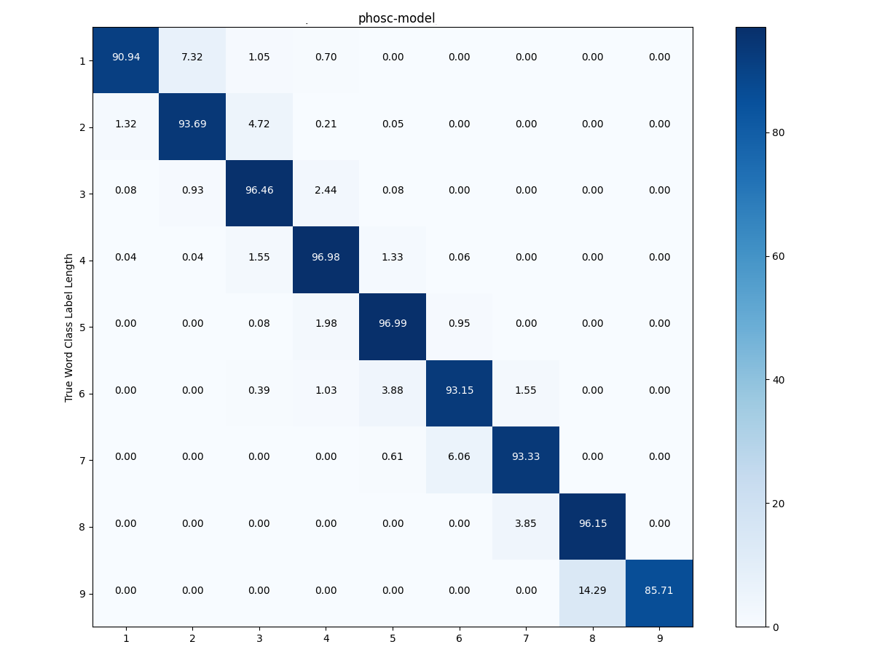
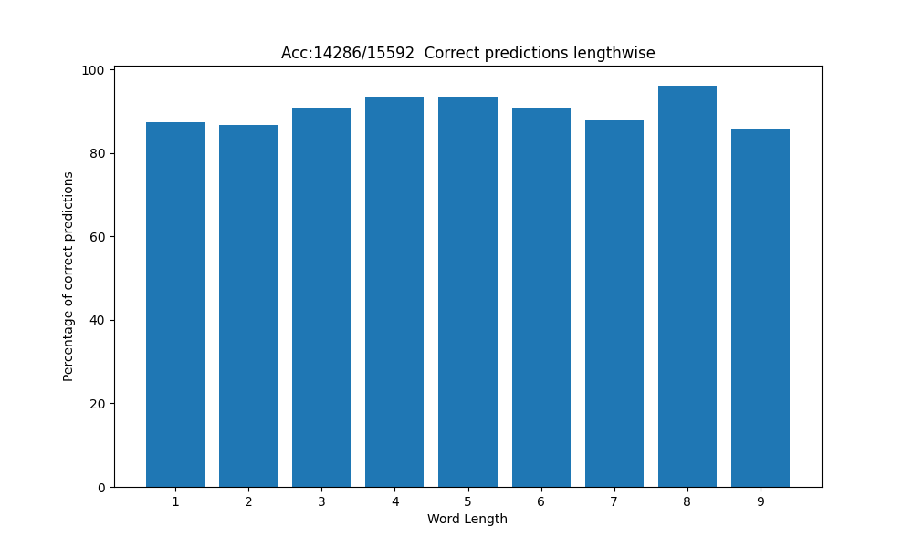
Model Results
Tested on 15592 words with 92% accuracy

Slide 30
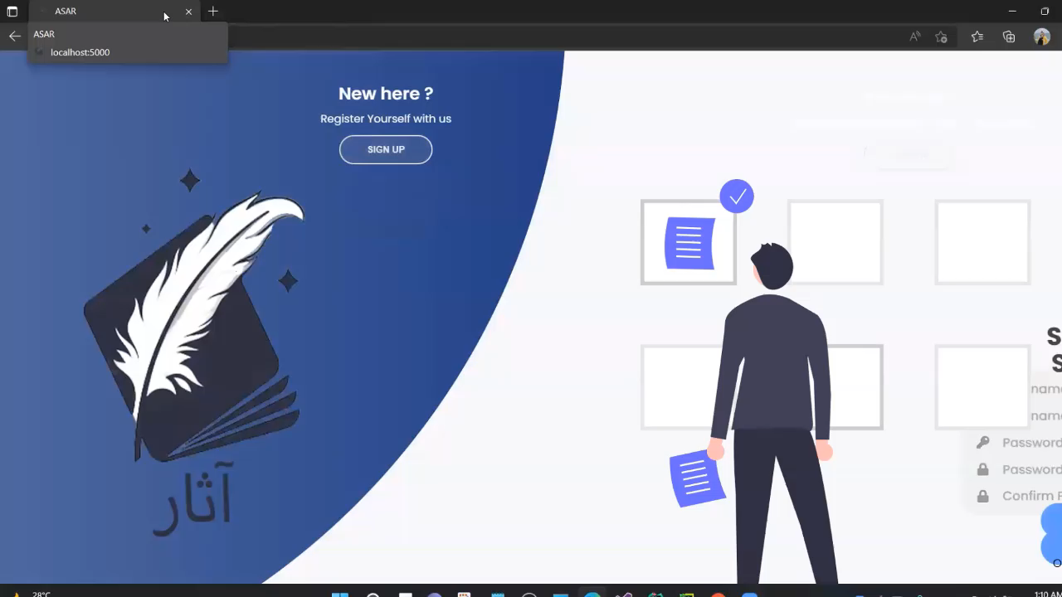
Demo

Slide 31
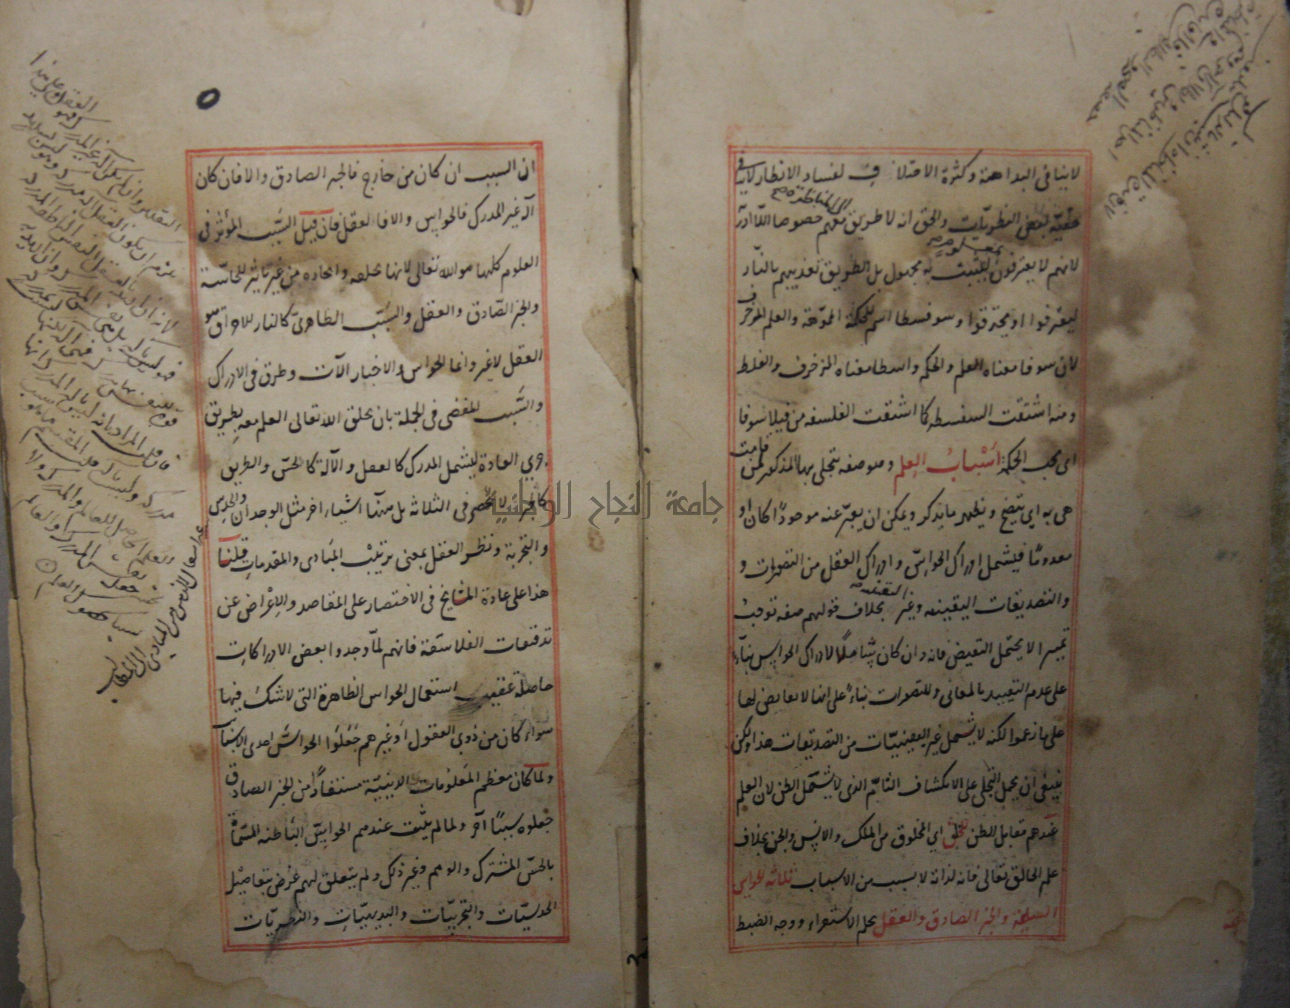
Future Work
Built indexing search engine
Investigate finding solutions for Arabic page segmentation problems like:
Connected components.
Marginal notes.
Border removal.
The lines are not straight.
Faded ink.

Slide 32
Thank You!
Questions?

